Slide 1

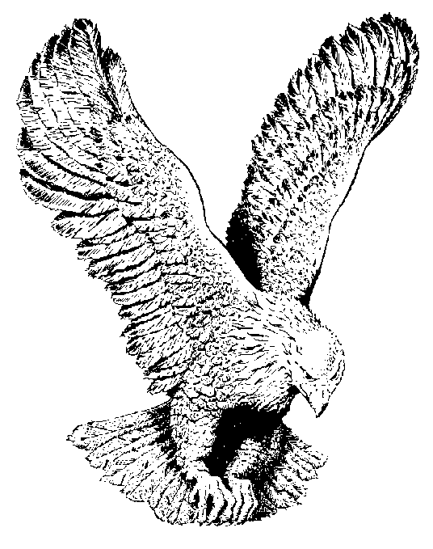
BE UNTO ME ACCORDING TO THY WORD
Be it unto me
According to your word,
According to your promises,
I can stand secure.
Carve upon my heart
The truth that sets me free,
According to your word, oh Lord,
Be it unto me

